Slide 1
Gayanara E-commerce Perfomance Review
Renaldy Bilal Setyawan

Slide 2
Executive Summary
Consistent revenue growth anchored by strong performance in Semarang and Depok.
Promotional spend of Rp31.4M has generated no measurable lift in average order value.
Anteraja shows an elevated cancellation rate that warrants investigation.

Slide 3
Rp. 1,265M
2,521
Rp. 502K
Total Revenue
Completed Orders
Average Order Value
(Excludes cancelled and returned orders. Jan 2022 – Feb 2025)

Slide 4
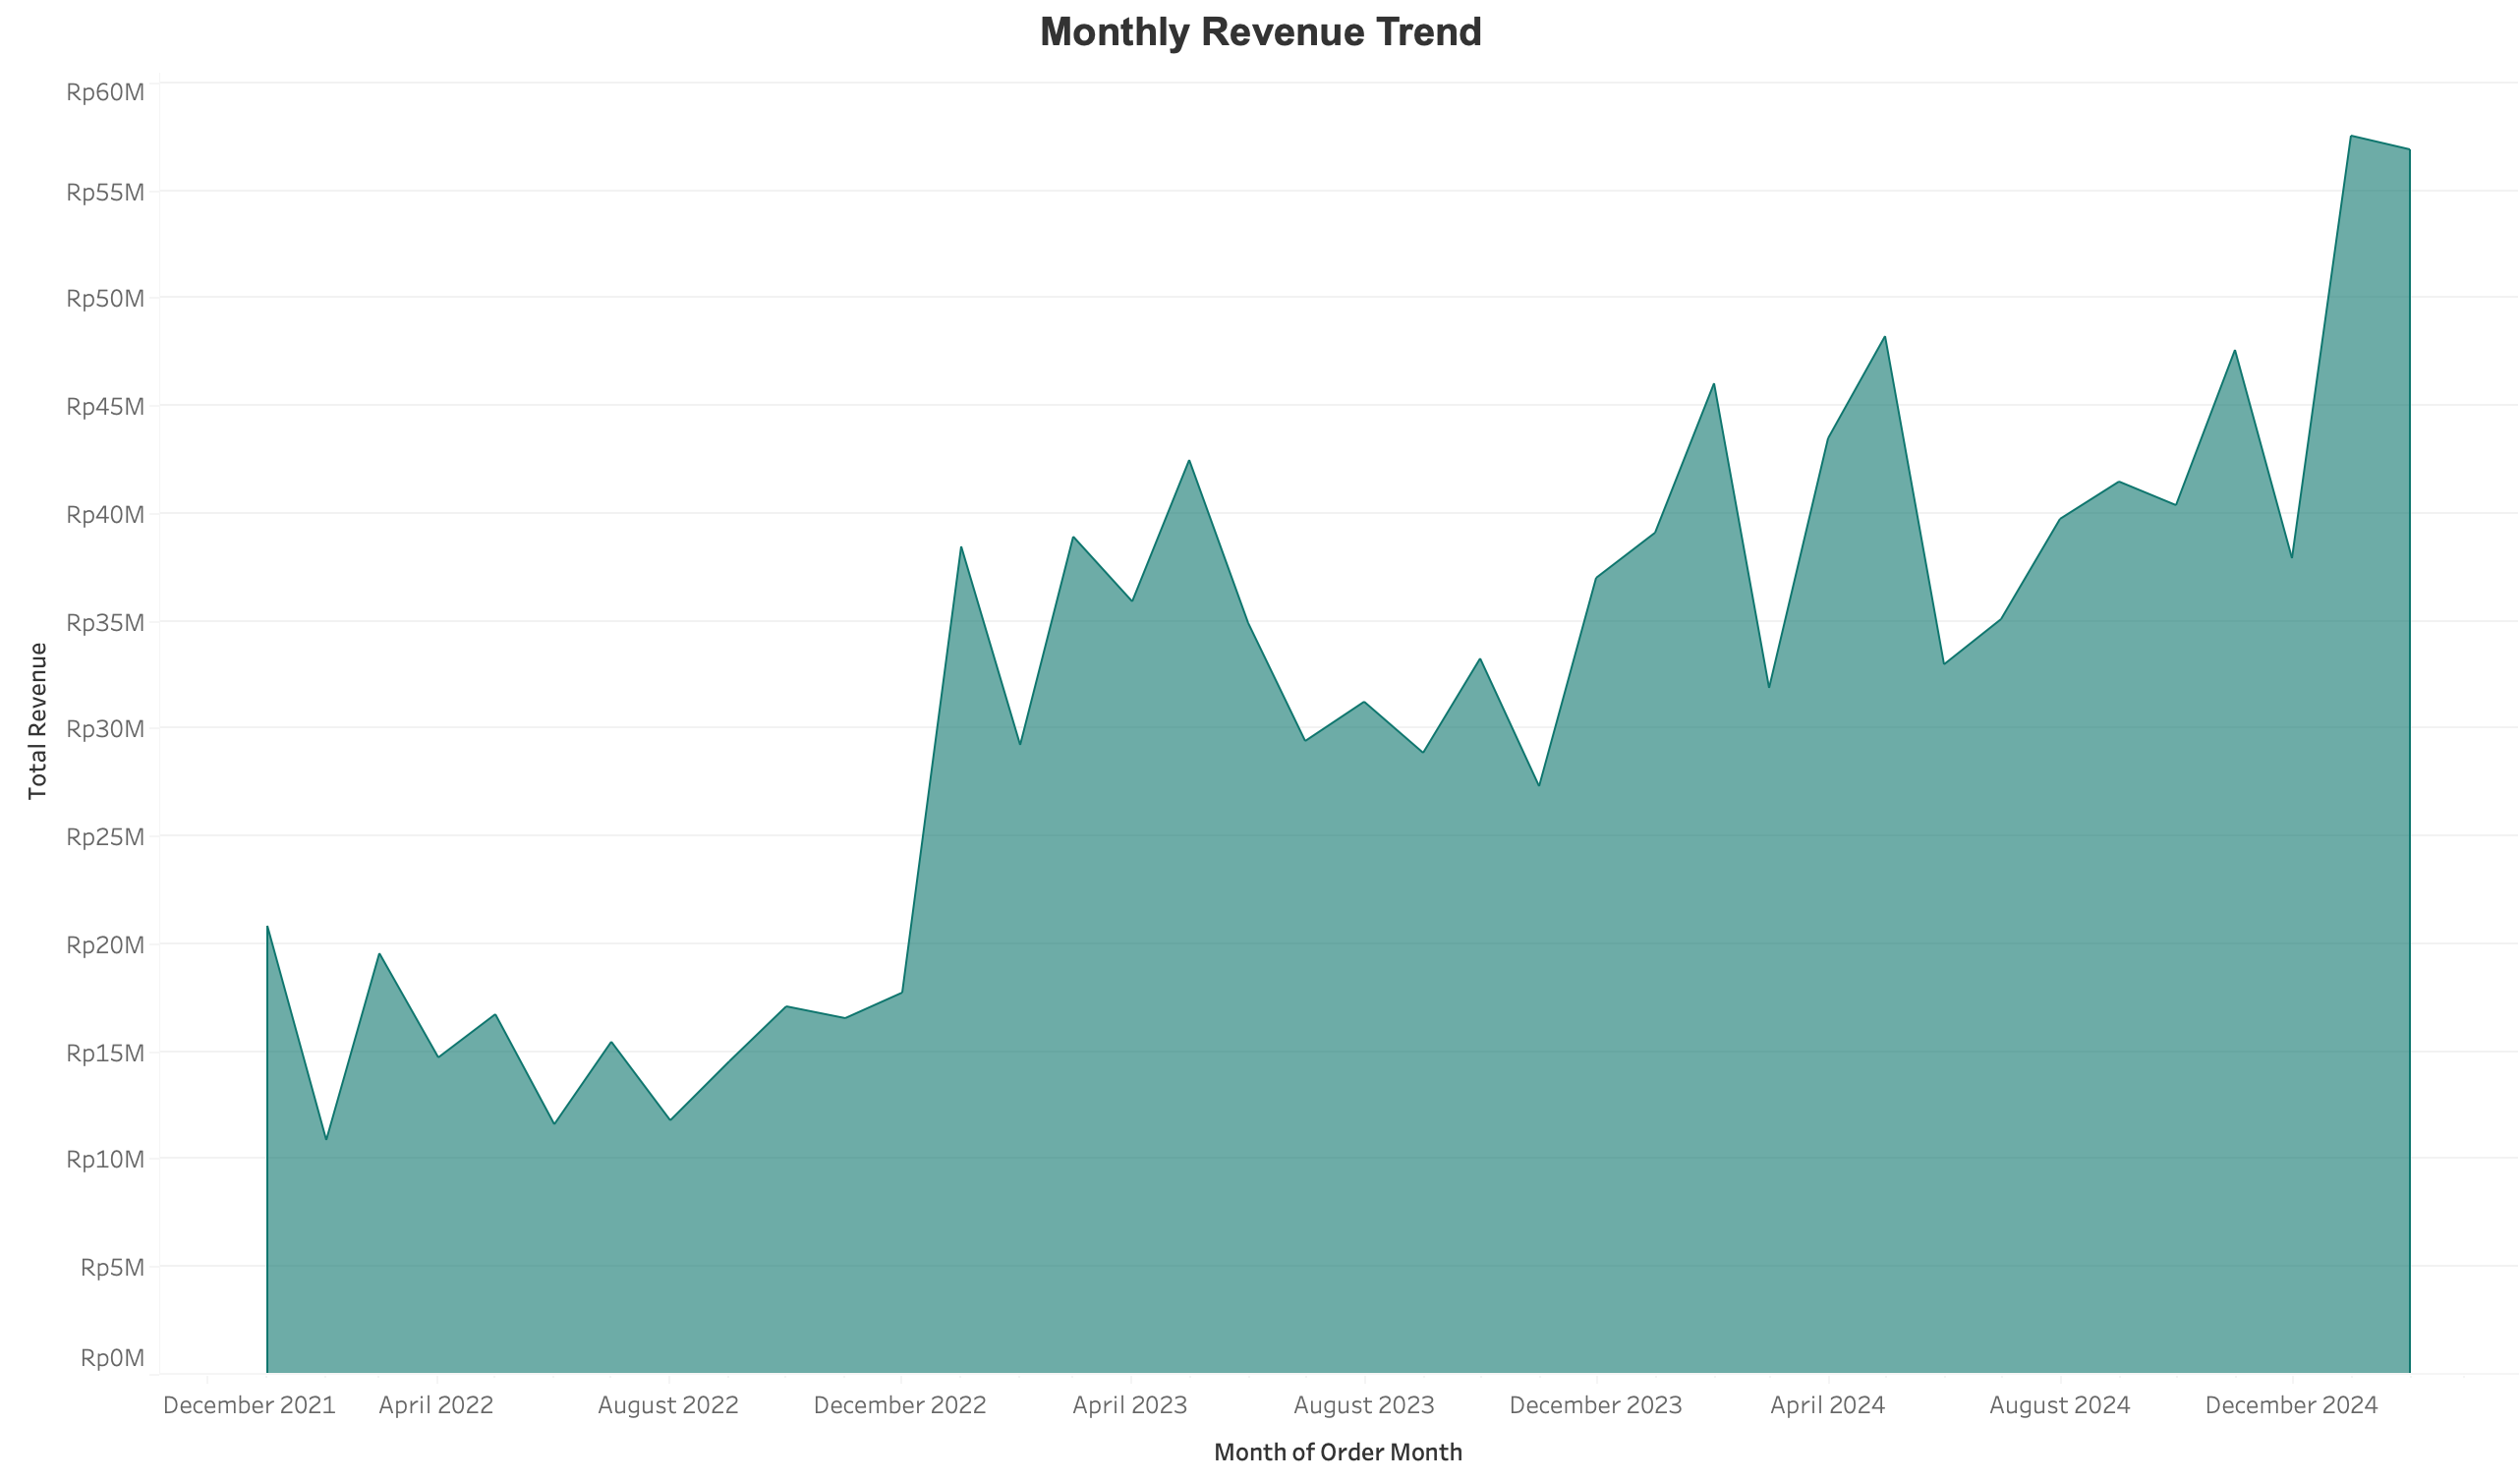
The Revenue Timeline
Revenue has shown a stable, upward trajectory since 2022, reaching its peak volume in early 2025.

Slide 5
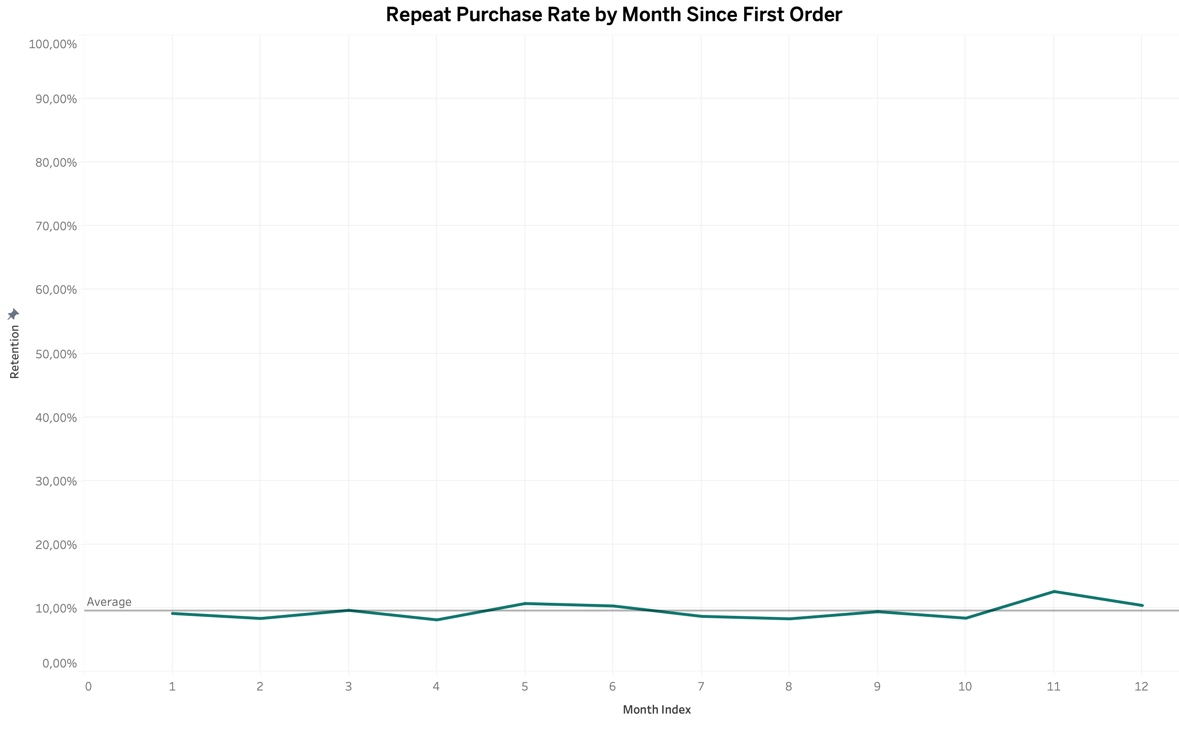

Retention doesn't decay — and that tells us something
What We Found: Repeat purchase rate holds between 8.1% and 12.6% from Month 1 through Month 12, with no downward slope (M1: 9.15%, M6: 10.32%, M12: 10.40%).
Why It Matters: Real retention curves drop steeply in Month 1 then flatten. A flat line means tenure carries no information — the signature of independent random draws. This is a property of the synthetic data, not a business finding.

Slide 6
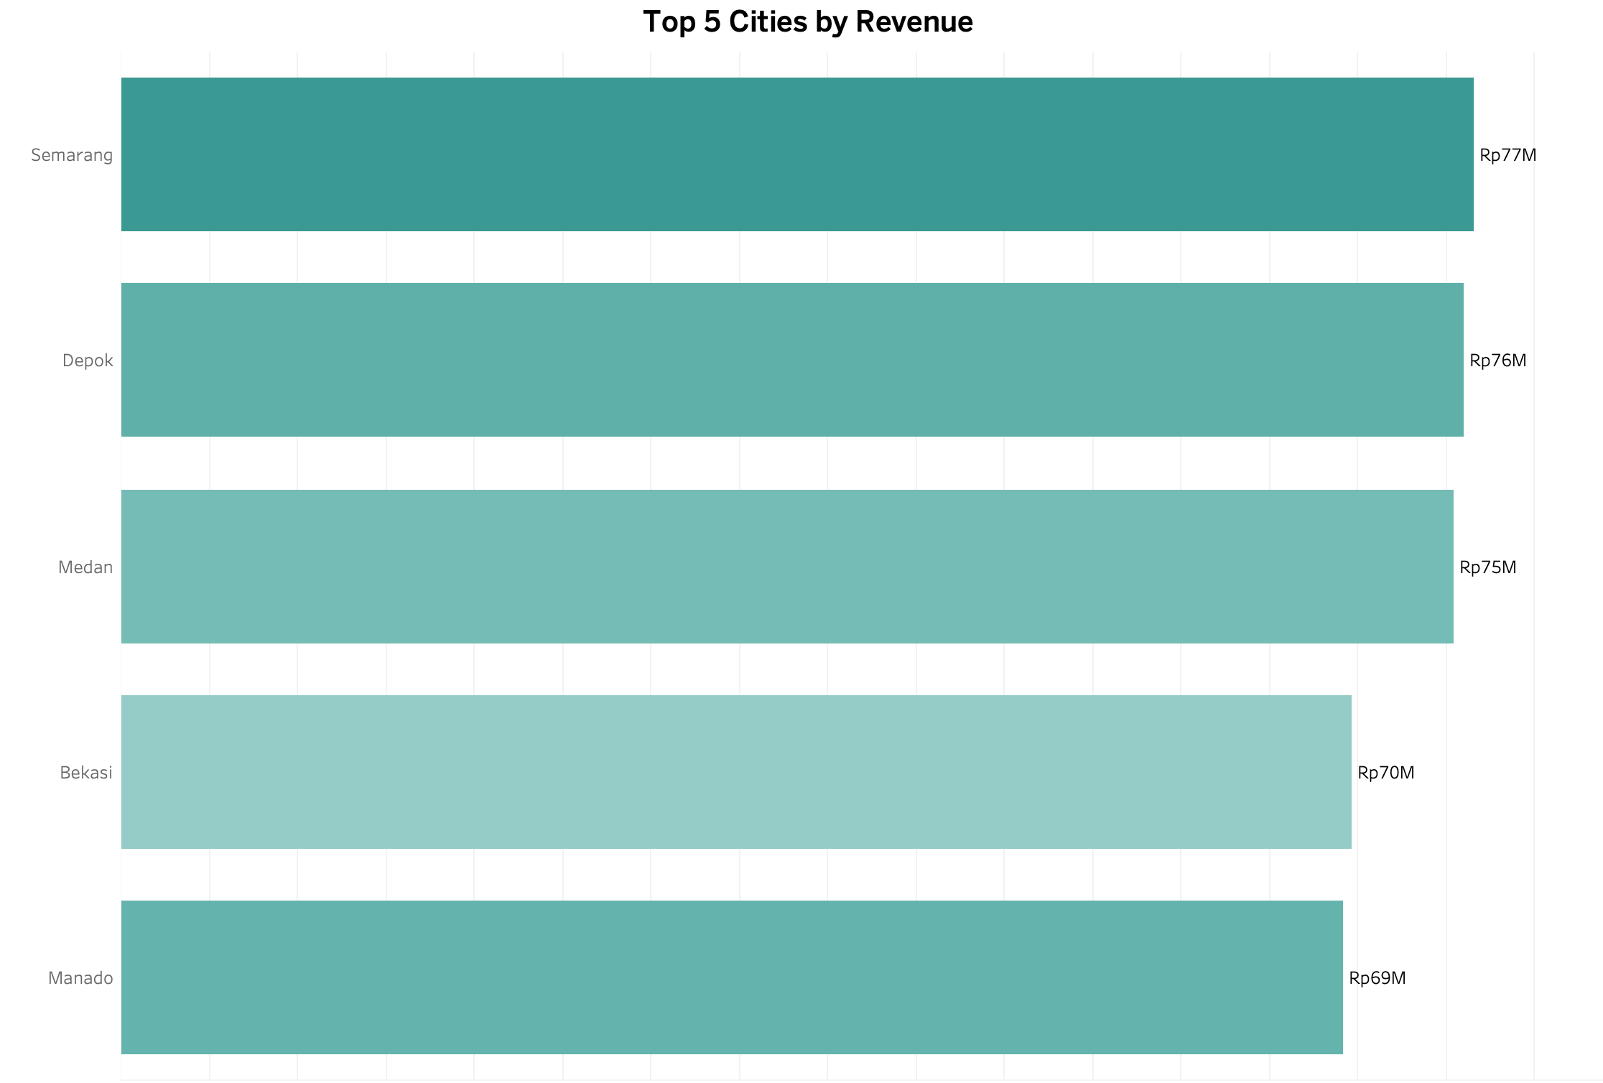
This growth is heavily concentrated in two dominant markets: Semarang (Rp77M) and Depok (Rp76M)

Slide 7
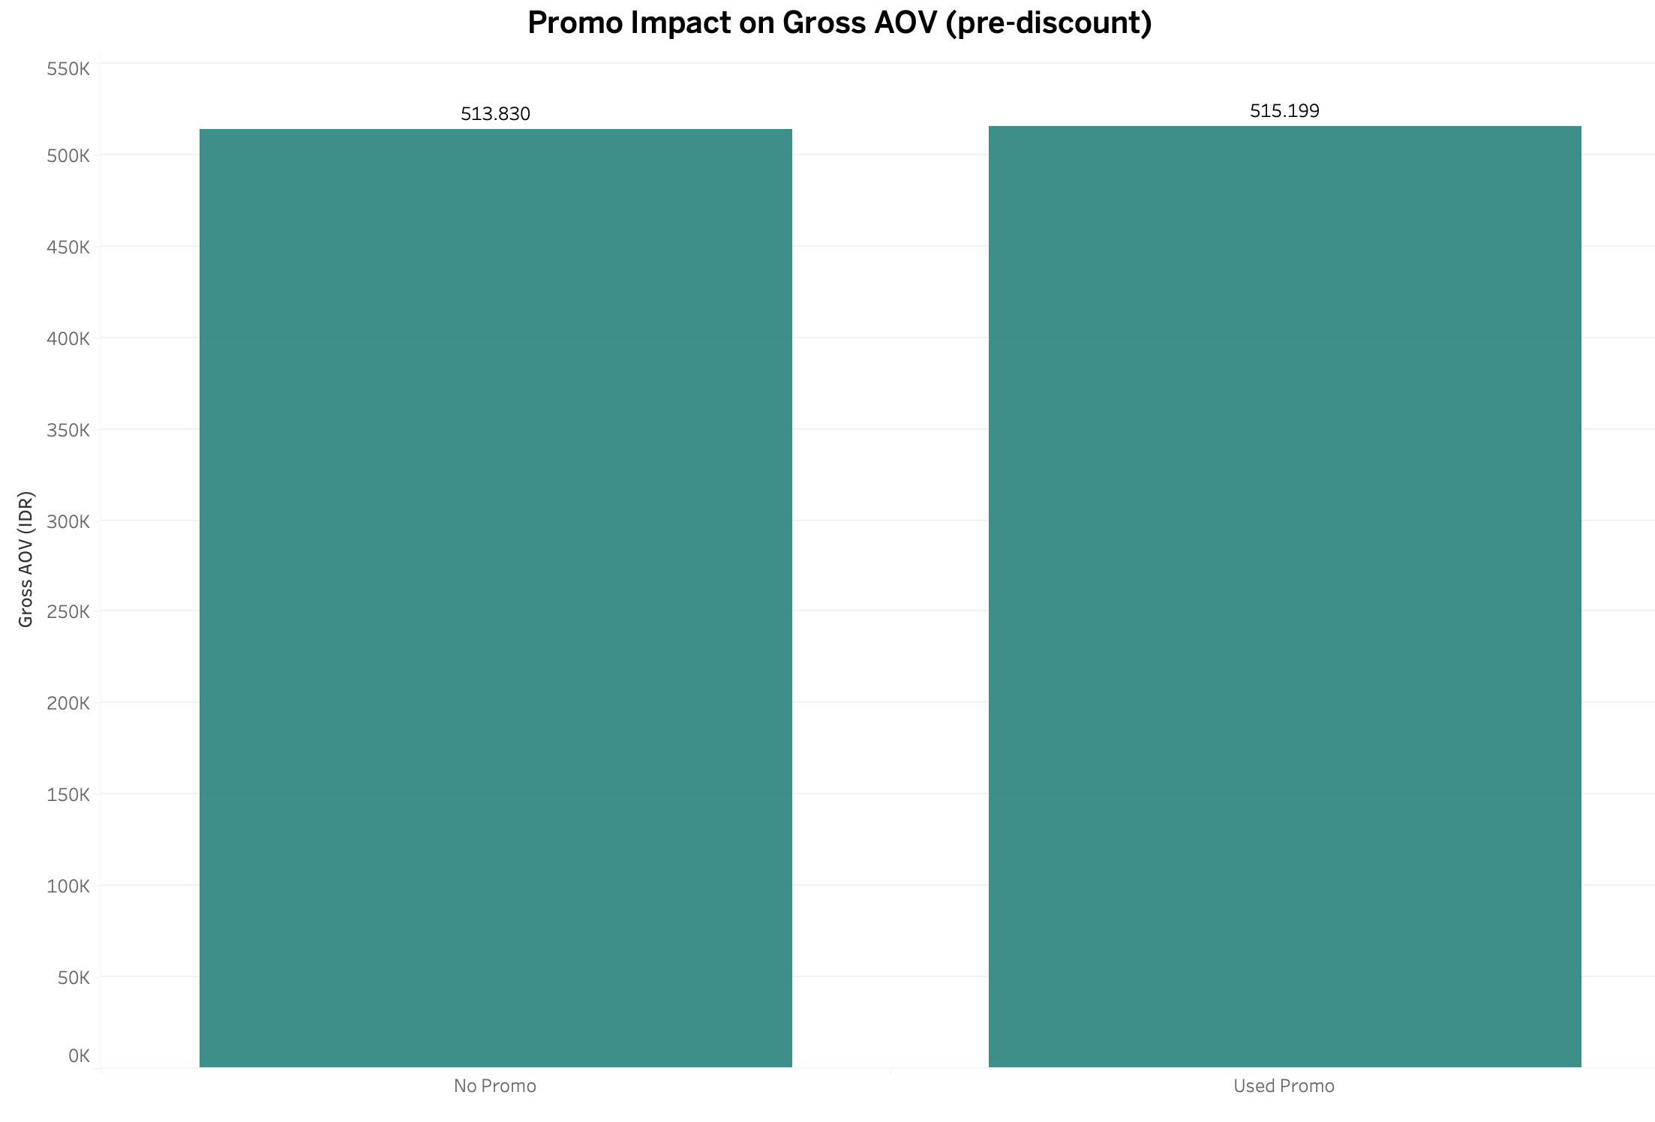
Rp31.4M in discounts, zero basket lift
What we found
Promo orders average Rp. 515K per cart versus Rp. 514K for organic orders statistically identical. The Rp31.4M spent on discounts bought no incremental spending.
The Fix
Transition to "Minimum Spend" thresholds (e.g., "Save Rp50K on orders over Rp600K") so the discount structurally requires a larger basket to unlock.

Slide 8
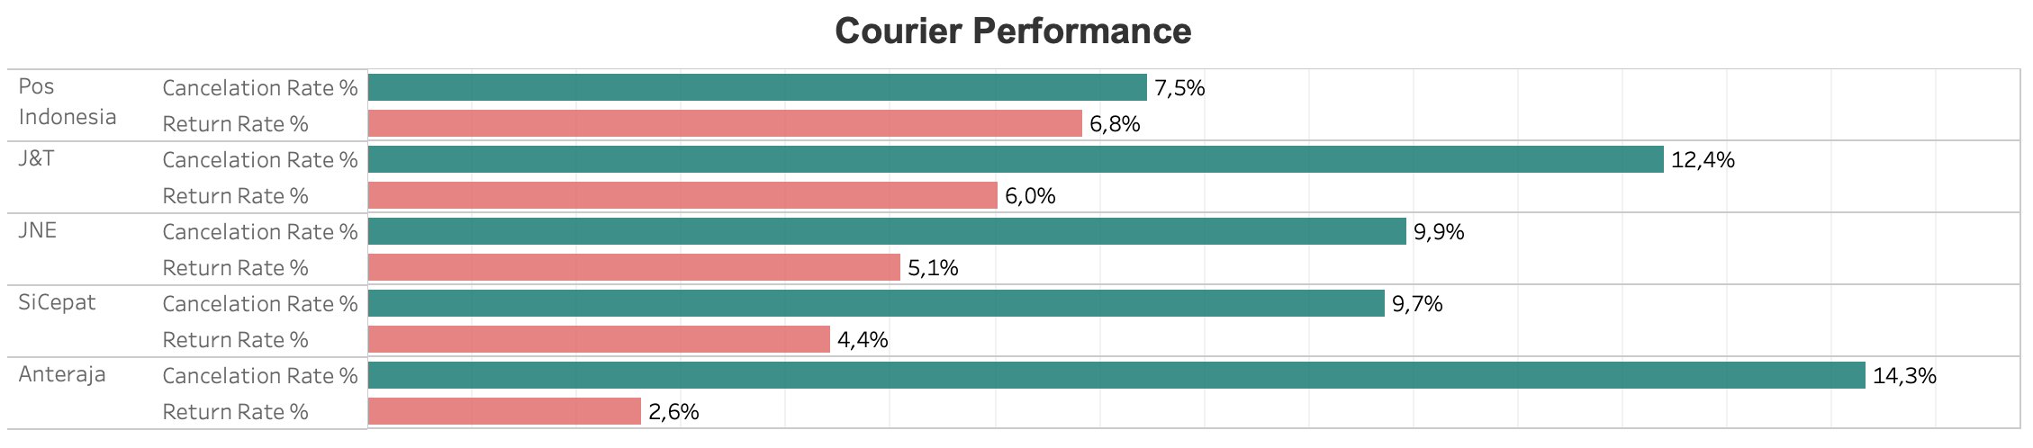
Anteraja's cancellation rate is 14.3% — worth investigating, not yet conclusive
The Bottleneck: Anteraja's cancellation rate (14.3%) is nearly double Pos Indonesia's (7.5%), but on only 307 orders and 44 cancellation events.
The Fix: Audit Anteraja's dispatch times and pilot a controlled volume shift in one region.
The Impact: Anteraja also has the lowest return rate (2.6%), suggesting pre-dispatch friction rather than delivery quality.

Slide 9
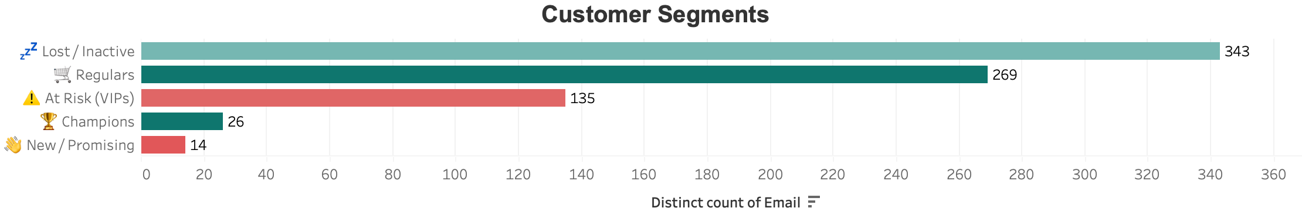
A critical retention risk exists, with 135 VIP customers currently 'At Risk' and 343 customers lost to inactivity
The marketing team needs to launch an immediate, targeted "win-back" email campaign offering a white-glove re-engagement incentive specifically for this At-Risk VIP tier.
135 customers with high frequency or spend have gone dormant past 60 days.

Slide 10
Immediate Priorities: Restructure Promos, Reroute Logistics, and Deploy VIP Win-Backs.
Phase out flat discounts immediately
Export the list of the 135 "At Risk (VIP)" users.
Ensure every discount is tied to incremental basket value rather than subsidizing purchases that would happen anyway.
Launch a highly personalized win-back email campaign this week offering a white-glove re-engagement incentive.
Audit Anteraja's dispatch times and pilot a controlled volume shift in one region
Measure pickup-to-dispatch times, then shift volume in one region and compare cancellation rates before and after.

Slide 11
What this analysis can and can't tell us
What holds up
Outside scope
Net revenue reconciles exactly to source (Rp1,265,340,379). Promo comparison uses like-for-like gross basket value. Courier rates reported with volume context.
• True promo ROI → no margin data available • Courier significance — Anteraja n=307, Pos Indonesia n=161 • Churn drivers → no lifecycle dynamics in the data
• Synthetic dataset — category revenue unrealistically flat, retention curve doesn't decay
All revenue figures are net of discounts, excluding cancelled and returned orders.
Reconciles exactly to source. Jan 2022 – Feb 2025.

Slide 12
Thank You
Let’s Connect. Always open to discussing data strategy!
Email : renaldybys@gmail.com
Portfolio : Click Here!
Dataset : Click Here!
Tableau Public : Click Here!

